Slide 1




Emission and Economic Implications for Canada of Using Small Modular Reactors (SMRs) in Heavy Industry
Research supported by:
Research by:

Slide 2
Executive Summary
Research conducted by EnviroEconomics and Navius Research studied the economic and climate implications of employing small modular reactors (SMRs) in Canada’s high-emitting industrial sectors.
Much of the focus on SMRs has been on their ability to supply clean electricity into the grid. But, of equal importance is their potential to decarbonize heat and power in Canada’s industrial sectors. Oil sands, chemical manufacturing and mining currently contribute more than 30 per cent of Canada’s greenhouse gas emissions and face enormous challenges in reducing them.
SMRs are particularly well-suited for these sectors given their ability to generate reliable, carbon-free electricity, and heat, with a much smaller land footprint than current reactors. These SMRs are often factory-constructed and modular, which means they are easily transported to remote or challenging locations.
The model used by EnviroEconomics and Navius Research, which has been leveraged by several organizations including the Canadian Institute for Climate Choices and the International Council on Clean Transportation, explored a variety of cost and technical assumptions for deploying SMRs, which are currently in the research and development phase.
Across all scenarios, SMRs delivered low-cost emission reductions, driving down the cost of getting to net-zero as a nation. With deployments set to begin as early as 2026, SMRs could be widespread by 2035 as the demand increases rapidly for reductions in the industrial sector.

Slide 3
Highlights of the Data
Between 2035-2050, SMRs could reduce GHG emissions by 216 megatonnes (Mt)* in the heavy industrial sector (Canada-wide emissions are approximately 700 Mt per year). That is the equivalent of removing all current emissions from the oil and gas sector for a one-year period** or taking more than three million cars off the road each year in Canada.
Beyond their value in cutting GHG emissions in the Heavy Industrial Sector by 18 per cent by 2050, SMRs could lower the country’s cost of reaching net zero by more than five per cent and contribute up to $5 billion to GDP annually by 2050. This economic benefit comes from balance sheet savings for industry, with SMRs in some applications less expensive than alternatives.
The introduction of SMRs to the industrial sector means that other technologies being considered - hydrogen, carbon capture utilization and storage, and renewable natural gas - which are widely needed and scarce, could be deployed elsewhere, potentially reducing GHG emissions and expenditures even further.
* Megatonnes - Standard measure for GHG reduction
** Sourced from Government of Canada GHG Emissions

Slide 4
Key Results
SMRs could lower the country’s cost of reaching net zero by more than five per cent and contribute $5 billion to GDP per year by 2050, versus a scenario where SMRs aren’t available.
SMRs could contribute to getting to net zero by reducing GHG emissions by 14 Mt per year on average, the equivalent of taking over three million cars off the road per year.
Between 2035 and 2050, SMRs could reduce GHG emissions by 216 Mt in the industrial sector, which is more than the yearly GHG emissions created by all types of transportation across Canada.
The deployment of SMRs will reduce the cost for the pathway to NetZero 2050 in large industry. When comparing GHG reducing technologies, SMRs provide a lower cost option for industry versus technologies like hydrogen, carbon capture utilization and storage, renewable natural gas, and other approaches. Additionally, by adding SMRs to large industry, reducing Canada’s overall GHG emissions can be done for a cheaper cost than if SMRs were not available.
By using SMRs as a GHG reduction method in large industry, SMRs can displace the need for hydrogen and renewable natural gas technologies to decarbonize this industry. Instead, these displaced technologies can be used to reduce GHG emissions cheaper and easier in other industrial, household and transport heat and power applications.

Slide 5
Key Results (continued)
Across the range of the cost and technical feasibility assumptions tested, SMRs continued to deliver low-cost emission reductions.
The modelling demonstrated SMRs will become very important after 2035 as more reductions from the industrial sector are needed to achieve net zero, as most other sectors will be abating heavily by this point and industry will need to catch up.
Note: The modelling assumed that the Liberals’ announced carbon price of 170$/tonne is the price input in the early 2030’s, coinciding with the introduction of SMRs and that that price triggers significant SMR adoption that accelerates after that point as carbon pricing rises under various scenarios.

Slide 6
Outline
1. Project Overview 2. Canada’s Net Zero Challenge 3. Decarbonizing Canada’s Heaviest Industries 4. Lessening the Economic Cost of Net Zero
5. Methodology Annex

Slide 7
The Project Overview
The Canadian SMR Secretariat hired EnviroEconomics to perform the study using Navius Research’s gTech model, a regionally explicit dynamic recursive CGE model forecasting economy, energy and GHGs to 2050.
EnviroEconomics has divided the Project into two phases:
Phase 1: SMRs Used to Decarbonize Canada’s Industrial Heat and Power
Regionally and sectorally explicit energy and emissions modelling to net zero by 2050.
Modelling and analysis complete.
SMRs used for high grade industrial heat and power in Canada’s large emitter sectors, >75 MW.
Sectors are oil sands, heavy oil upgrading, oil refining, mining, and chemistry.
High degree of uncertainty on cost and feasibility; multiple scenarios of cost and technical feasibility.
Next: Phase 2: SMRs Used to Decarbonize Canada’s Electric Power Grid
Regionally explicit electricity sector modelling.
Scope and timing to be determined.

Slide 8
Key Insights from Phase 1
SMRs are a “net-zero” compliant technology for industrial emitters that successfully competes with other emerging abatement opportunities.
GHG reductions are in the range of <1 Mt to 43 Mt, averaging 14 Mt per year.
60 to 190 (in the range of 100 to 300 MW) units deployed in the model, central run is 19,000 MW by 2050.
SMRs lower abatement costs relative to alternative pathways, reducing the carbon price needed for a 2050 net-zero pathway.
SMRs can eliminate 18% of Heavy Industrial GHG emissions.
SMRs free up low emitting energy carriers such as hydrogen and RNG to be used elsewhere.
With SMRs, GDP gains to Canada in 2050 in the order of $5 billion (central run).

Slide 9
Overview
10 SMR deployment scenarios were modelled
Modelling and analysis explored GHG emissions benefits and economic outcomes of SMR cost and feasibility scenarios, with a view to helping Canada reach net zero emissions by 2050.
Emission Pathways
Canada’s 2030 target to net zero: Current policy to 2030, 105 Mt in 2050.
Study simulated 10 SMR scenarios achieving the same GHG pathway.
These scenarios shifted GHG reduction burden among economic sectors, to hit the same target.
Results show that SMRs contribute emission reductions relative to a “no SMR” scenario.
In Phase 1, SMRs were applied to high grade industrial heat and power in the large emitter sectors, ~100 MW applications.
This explicitly competes SMRs against other emerging emission abatement options.
Note: Green hydrogen potential was not modelled – inclusion of hydrogen could expand the prospective benefits of using SMRs in Canada.

Slide 10
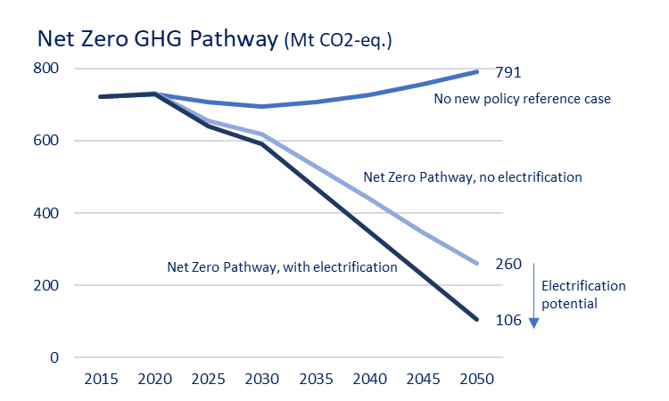
Background: Canada’s net zero emissions pathways
(assumes existing policies)
(policies driving to net zero but without shifting activities toward more intense use of electric power)
(emission reductions available from electrification)

Slide 11
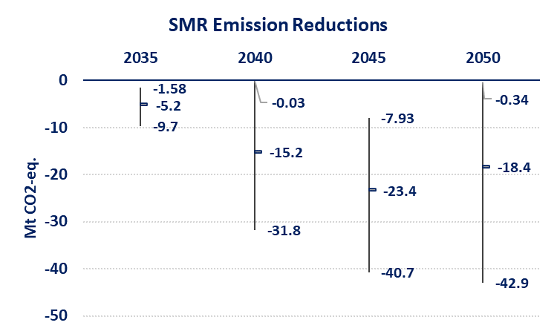
National Emission Reductions from SMRs
GHG reductions from SMRs are in the range of:
<1 Mt to 43 Mt, averaging 14 Mt per year.
SMRs are widely deployed after 2035 to address the high carbon costs of the GHG pathway to net zero.
The high cost scenarios show low penetration. With lower SMR costs, deployment is widespread.
SMRs shift GHG reductions from other high cost sectors and make it feasible to obtain more reductions from the industrial emitters.
SMRs free up low emitting energy carriers such as hydrogen and renewable natural gas to be used elsewhere, potentially with higher environmental benefits.
In the simulations, the SMRs are a transformative technology that successfully compete with a range of emerging abatement opportunities to reduce industrial GHGs.

Slide 12
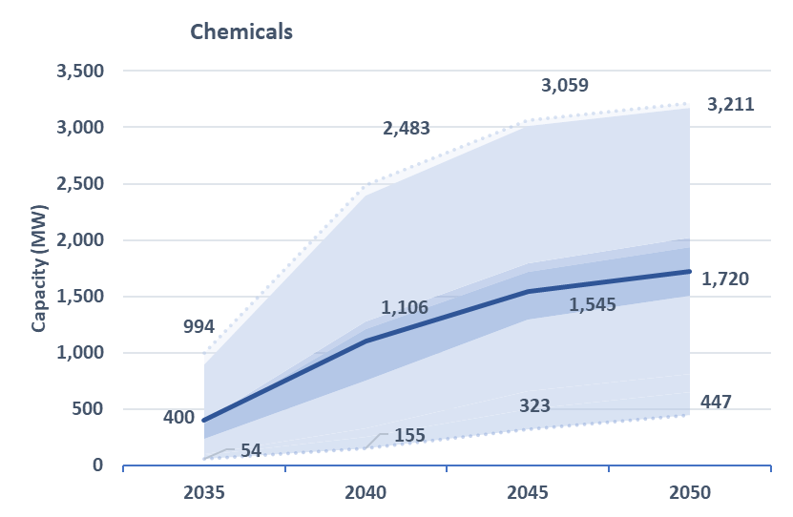
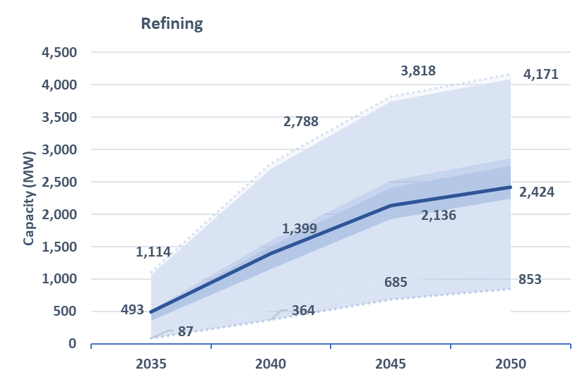
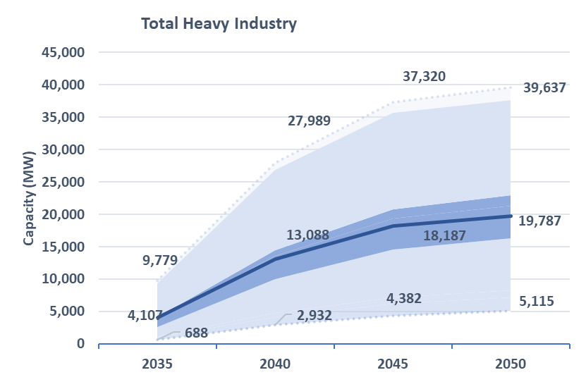
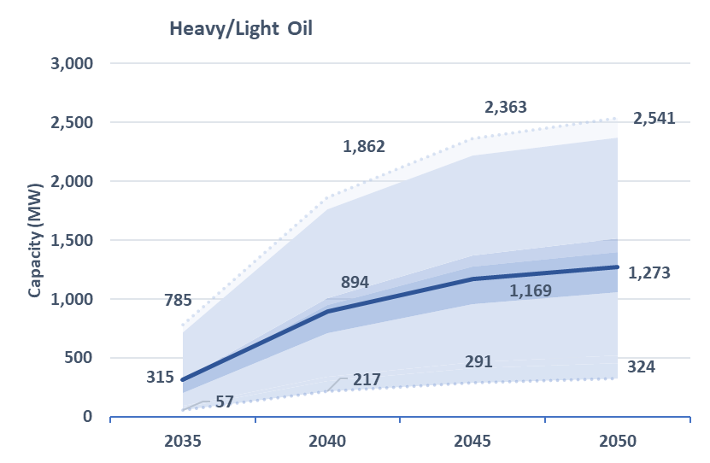
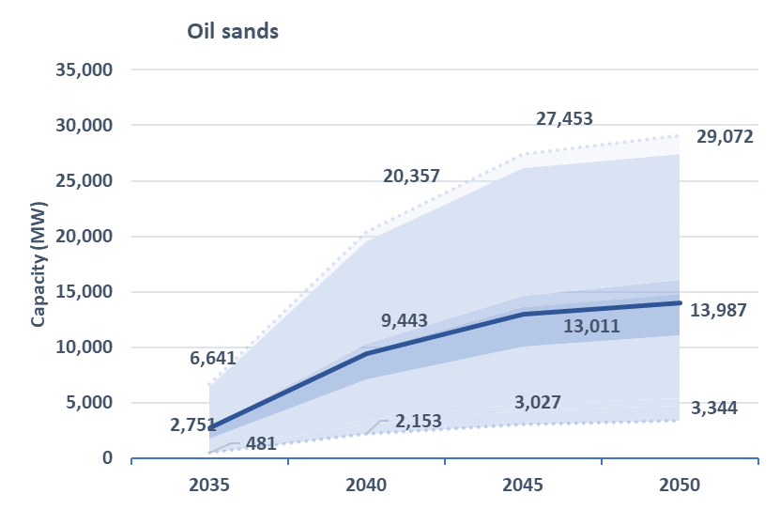
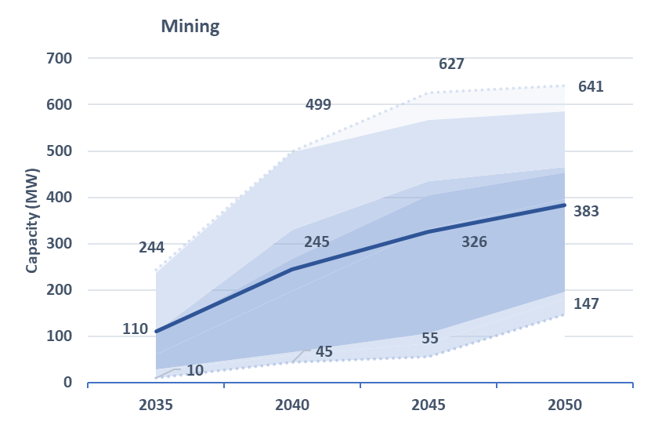
Installed SMR Capacity: MW in Industrial Sectors (2035 to 2050)

Slide 13
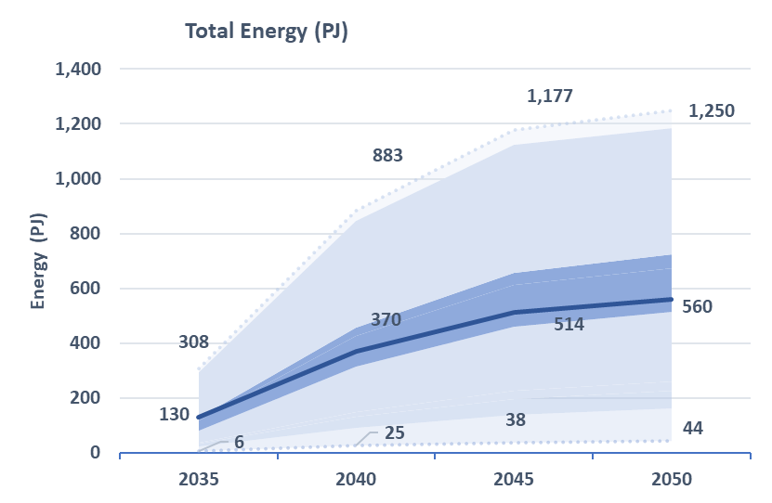
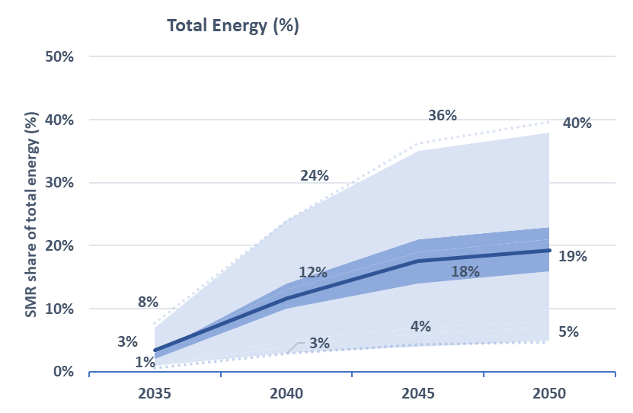
Share of Total Energy: Large Industrial Emitters (PJ and % of Total Energy)

Slide 14
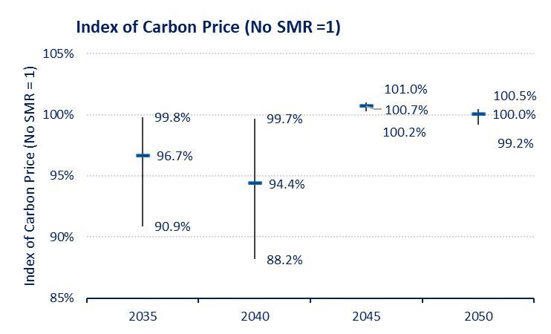
Carbon Price: Index of Carbon Price (No SMR = 1)
Most SMR scenarios lower the carbon prices paid by households and industry to hit the same GHG pathway:
SMR availability makes reductions cheaper for large industrial emitters.
This also replaces higher cost GHG abatement options in other sectors of the economy.
Frees up low carbon energy carriers like hydrogen and renewable natural gas (RNG) to be used elsewhere in the economy.

Slide 15
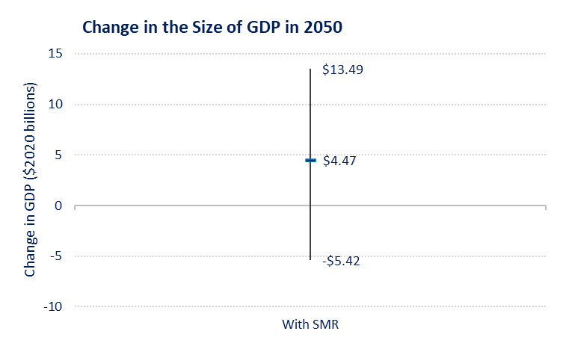
GDP: Size of Economy in 2050 (Benefits for cumulative growth in the economy)
Lower carbon price results in GDP uplift relative to no SMR scenario. That is, SMRs make it cheaper in the simulations to hit the same GHG target relative to a no SMR scenario.
Seven of nine SMR scenarios result in a larger total economy in 2050 relative to a scenario with no SMRs:
With SMRs, the economy is on average, $4.5 billion larger in 2050.
The SMR cost scenarios from the SMR Roadmap indicate the potential to lower the costs of an emission pathway to net zero by mid-century.

Slide 16
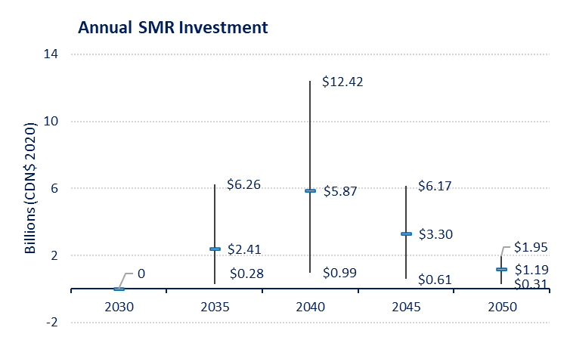
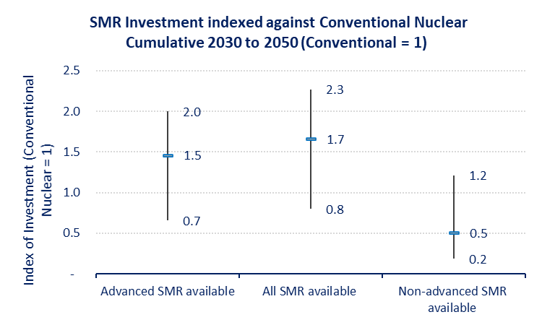
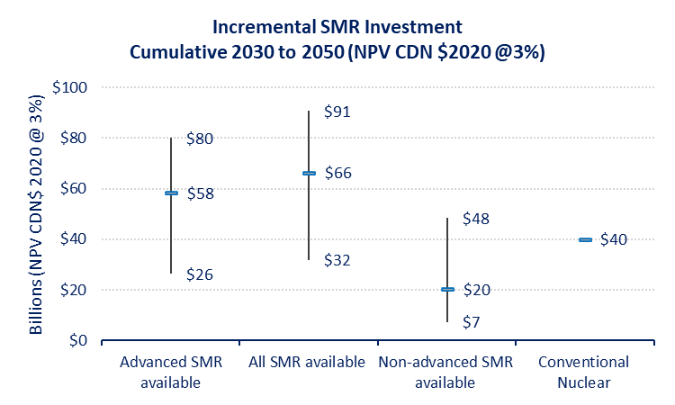
SMR Investment: Cumulative 2030 to 2050; Indexed against conventional nuclear; and Annual

Slide 17
Methodology Annex
High degree of uncertainty on SMR cost and feasibility.
Low, medium, and high SMR cost scenarios to reflect a range of possible outcomes. Report uncertainty ranges.
Assume feasibility of the technology is probable after 2031.
Apply only to high grade heat and power demand from large industrial emitters in the mining, oil sands and upgrading, heavy oil, petroleum refining, and chemicals sectors.
Levelized cost of energy (LCOE) for SMR technologies is based on the cost assumptions for commercially deployed SMRs as estimated in the SMR Roadmap report by the Economics and Finance Working Group.
Differentiate between two SMR technologies:
1) design like current large reactors with a higher technology readiness level (TRL); and,
2) a differently designed, more advanced SMR technology with lower TRL.
SMR Roadmap provides O&M cost estimates for TRL high and low SMRs; benchmarks against combined cycle natural gas turbine (NGCC):
High TRL SMR: LCOE $87/MWh. Low-cost scenario is –27% and high costs is +34%
Low TRL SMR LCOE $80/MWh. Low-cost scenario is –21% and high costs is +39%
30-year life with discount rate of 6.15% for high TRL SMR; 9% for low TRL SMR.

